Slide 1
Fundamentals of Networks and Security
Markos Vassilis
Mediterranean College
Week 08

Slide 2
A Quick Revision

Slide 3
What we saw last time… 1 / n
In which layers does Ethernet operate?
Layer 1 (physical), since it is related signal transmission (remember the cables?)
Layer 2 (data link), since it connects physical devices (implements the LAN).
Name some typical cable types.
UTP: Unshielded Twisted Pair cables
STP: Shielded Twisted Pair cables
Coax: Coaxial Cables
Fibre optics

Slide 4
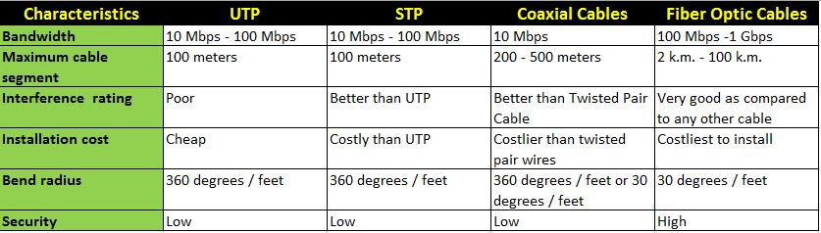
What we saw last time… 2 / n
Compare UTP, STP, Coax and Fibre cables.

Slide 5
What we saw last time… 3 / n
What are the LLC and MAC Layer 2 sublayers?
Logical Link Control (LLC):
The “upper” sublayer of layer 2.
Connection handling between lower / upper layers.
Adds control info to help deliver the packet to destination.
Medium Access Control (MAC):
The “lower” sublayer of layer 2.
Data encapsulation.
Media access control.
Mostly hardware.

Slide 6
What we saw last time… 4 / n
What does CSMA/CD stand for? How does it work?
CSMA/CD stands for Carrier Sense Multiple Access / Collision Detection. It works as follows:
Is there any signal carried by the medium (cable)?
If no → send data.
If yes → collision!
How to solve? → Wait a random amount of time.

Slide 7
What we saw last time… 5 / n
What does CSMA/CA stand for? How does it work?
CSMA/CA = Carrier Sense Multiple Access / Collision Avoidance. It works as follows:
Is there any signal carried by the medium (cable)?
If no → send a notification that you want to use it.
If no one objects → send data.

Slide 8
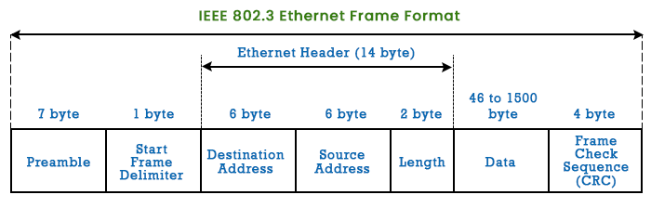
What we saw last time… 6 / n
What is the structure of an Ethernet frame (bytes, headers etc)?

Slide 9
What we saw last time… 7 / n
Name some special MAC addresses and their purpose.
All zeros: 00000000 00000000:00000000 00000000:00000000 00000000
Placeholder → Address not known yet.
All ones: 11111111 11111111:11111111 11111111:11111111 11111111
Broadcast → Send to all
MAC starting with 01-00-5E → Multicast

Slide 10
What we saw last time… 8 / n
Compare MAC and IP Addresses.
MAC Address:
Does not change
Physical address (assigned to NIC)
Assigned by Manufacturer (as per IEEE instructions)
IP Address:
Can change (like your postal address)
Bases on host location
Logical address
Assigned by network admin each time it is required

Slide 11
What we saw last time… 9 / n
How does ARP work?
Note down any incoming IP + MAC (for future use).
When you don’t know what to do:
Broadcast incoming messages to all devices (known IP, “all ones” MAC).
If there is someone to respond → Note down their MAC.
If no response is received → Well, nothing to do, drop the packet.
Overall:
If the destination IPv4 host is on the LAN, then the destination MAC is that of this device (@ this host).
If the destination IPv4 host is not on the LAN, the destination MAC is determined by the ARP process (table look-up).
If the ARP table does not include a valid entry, make a request (shout out) to get the MAC address related to that IP.

Slide 12
Addressing Addressing

Slide 13
Sending a Letter
Alice wants to send a letter to Bob. To do so, she writes up the letter and goes to the post office. There, she drops the folder to the post box…
What Alice does know:
That she has dropped the folder into the box - she has sent the letter.
What Alice does not know:
Did the post office send it?
Did Bob receive it?
Did Bob read it?
Will Bob reply?
Will Bob’s potential reply arrive? When?

Slide 14
Sent a Letter?
This is known as best effort delivery - but, one’s best is not always “good enough”.
Bob(‘s address) might not even exist - dead, moved to another part of the globe
Alice (or the post office) does not check about such things.
There is no connection between Alice and Bob before they have exchanged letters → connectionless communication.
This is the almighty IP…
Unreliable, clumsy, much like a typical post office.
Yeah, but, why do we use it?

Slide 15
Precision does not (always) matter
IP is logical or physical addressing?
Logical!
So, IP lives in layer…
3
Which means that IP does not care about physical media (+1 for IP).
Also, data is actually lost all the time (some times…) in telecommunications…
…so, IP occasionally losing some data is not that bad.
Moreover, sometimes data are critical to not get lost for some time…
…so, beyond that time interval, does it really matter?
There are 4 other layers above IP, so, they might come in handy…

Slide 16
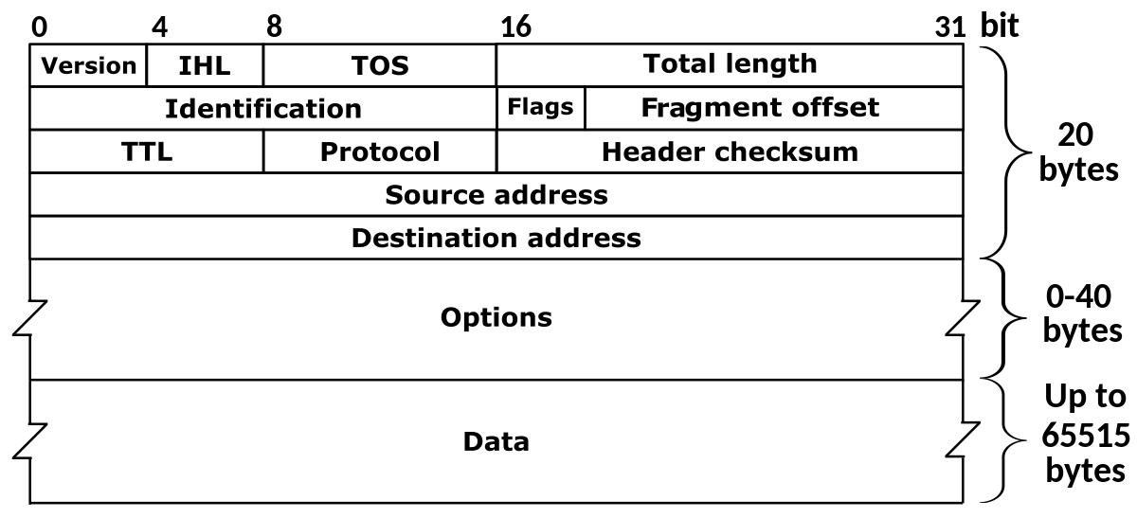
IPv4 Packet Header
Encapsulation: IP Packets = Segments (Layer 4) + IP Header.
Usually 20 Bytes (but things can get longer, up to 60)

Slide 17
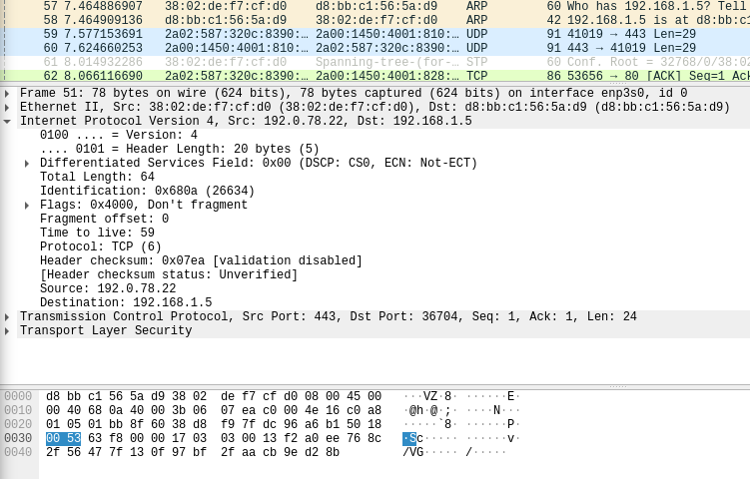
Play around with Wireshark!

Slide 18
The anatomy of an IPv4 Address
00000000.00000000.00000000.00000000 → Four octets of bits (four Bytes)
Each octet ranges (in decimal) from 0 to 255 (i.e., 2^8 - 1).
Each IPv4 has two parts:
The network part: LAN, Subnet etc.
The host part: device interface within the network.
The two parts are separated with the use of a subnet mask.
This way we also determine the size of the network (how many devices we can connect).
Devices in the same network communicate directly (e.g., LAN), devices in different networks need the help of a…
…Layer 3 device (router, L3 switch).

Slide 19
Converting Addresses
Convert this address from decimal to binary:
192.168.10.1
Brief reminder (decimal to binary):
Divide by two until you get 0.
Read the moduli of your divisions in reverse order.
Voilà!
You should get the following result:
11000000.10101000.00001010.00000001

Slide 20
(Reminder) Binary Operations: OR
Y OR 1 = 1, Y OR 0 = Y, i.e.:
0 OR 0 = 0
0 OR 1 = 1
1 OR 0 = 1
1 OR 1 = 1
Essentially, an OR bitmask can turn a bit to 1 (turn on). Assume that we want to turn the first four bits of 10101101 to 1. Then:
10101101 OR 11110000 11111101

Slide 21
(Reminder) Binary Operations: AND
Y AND 1 = Y, Y AND 0 = 0, i.e.:
0 AND 0 = 0
0 AND 1 = 0
1 AND 0 = 0
1 AND 1 = 1
Essentially, an AND bitmask can turn a bit to 0 (turn off). Assume that we want to turn the first four bits of 10101101 to 0. Then:
10101101 AND 00001111 00001101

Slide 22
(Reminder) Use case: Querying certain bits
Consider the following bitstring:
10011110 01110101
How can we easily query the status of their sixth bit (i.e., whether they are on or off)?
By using an AND bitmask and then comparing to zero:
10011110 AND 00100000 00000000
01110101 AND 00100000 00100000

Slide 23
Subnet Mask(ing)
Of the four octets of an IP address, the first 1, 2, or 3 octects correspond to the “network” part.
For instance, assume you have the following IP Address:
192.168.10.1
You know that the network portion comprises of the first 3 octets. How can use extract it?
You guessed correctly! (didn’t you?) Use a mask + AND:
11000000.10101000.00001010.00000001 11111111.11111111.11111111.00000000
11000000.10101000.00001010.00000000
AND

Slide 24
Subnet Masks
For a 1-octet network portion: 11111111.00000000.00000000.00000000
For a 2-octet network portion: 11111111.11111111.00000000.00000000
For a 3-octet network portion: 11111111.11111111.11111111.00000000
But, why be that verbose?
For a 1-octet network portion: 255.0.0.0
For a 2-octet network portion: 255.255.0.0
For a 3-octet network portion: 255.255.255.0
Even better:
For a 1-octet network portion: /8 → The number of “ones”.
For a 2-octet network portion: /16
For a 3-octet network portion: /24

Slide 25
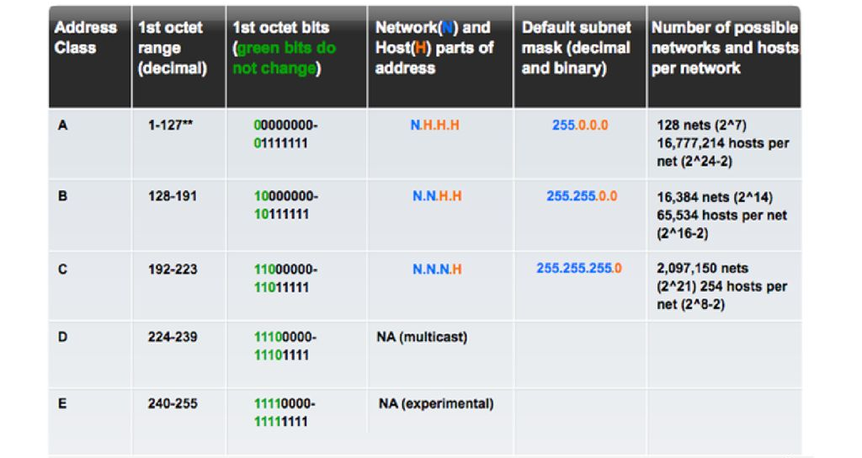
Legacy Classful Addressing
Why not 256?

Slide 26
Why not 256?
“All zeros” → Used for network definition.
Hence, this is not an available host address.
“All ones” → Broadcast address.
Hence, this is not an available host address.
Now, 2 ^ 8 - 2 = 256 - 2 = 254
Calculate on your own:
For the following IPv4, which are the network, host, and broadcast addresses (assume a /24 subnet mask):
192.168.10.15

Slide 27
Tips and Tricks
Is number (binary) 1011110101110101101001110001 even or odd?
Odd → since it ends with 1.
Is number (binary) 1111010111010110100111000100 even or odd?
Even → since it ends with 0.
Is a broadcast address even or odd?
Odd, since it always ends with ones.
Is the last usable host address even or odd?
Even, since it always is the broadcast address minus 1.
Is the network address even or odd?
Even, since it always ends with zeros.
Is the first usable host address even or odd?
Odd, since it always is the network address plus 1.

Slide 28
More Tips and Tricks
Is this a valid subnet mask? 255.127.0.0
Convert it to binary: 11111111.01111111.00000000.00000000
No, this is not valid! Subnet masks start with “ones” and end with “zeros”!
So, in decimal, the only odd number that can appear in decimal is 255 (elaborate on that and make sure you understand why!)
How many numbers are there between 4 and 10? (both inclusive)
Seven! (7)
How many numbers are there between 0 and 6? (both inclusive)
Seven! (7)

Slide 29
More on IPv4
Transmission: Uni-, Multi-, and Broad-cast.
Alice lives on a network and wants to communicate with Bob. She needs his public address
Public IPv4: Unique identifier that allows direct access to a host.
Who keeps them? IANA (Internet Assigned Numbers Authority)
There are also 5 RIR (Regional Internet Registries).
Private IPv4 addresses (local, non-unique, change over time).

Slide 30
IPv4: Private IP
Most common private ranges:
10.0.0.0 – 10.255.255.255 (10.0.0.0/8)
172.16.0.0 – 172.31.255.255 (172.16.0.0/12)
192.168.0.0 – 192.168.255.255 (192.168.0.0/16)
127.0.0.0/8 → Local host (“me”).
APIPA (Automatic Private IP Addressing):
169.254.1.0 – 169.254.254.255
More elegantly: 169.254.0.0/16
A device allocates this to itself when it does not receive a response from a DHCP server.

Slide 31
NAT, PAT, and… Trap
Network Address Translation (NAT): Converts private to public IPv4 (e.g., through a firewall or other devices).
Port Address Translation (PAT): Converts many private IP to one public IP.
How many IP are there?
256 * 256 * 256 * 256 = 2 ^ 32 = 4,294,967,296 ~ 4 billion.
How many people are there?
At the moment, roughly 8 billion.
IP depletion → Not enough IP for all of us.
How to solve this problem?

Slide 32
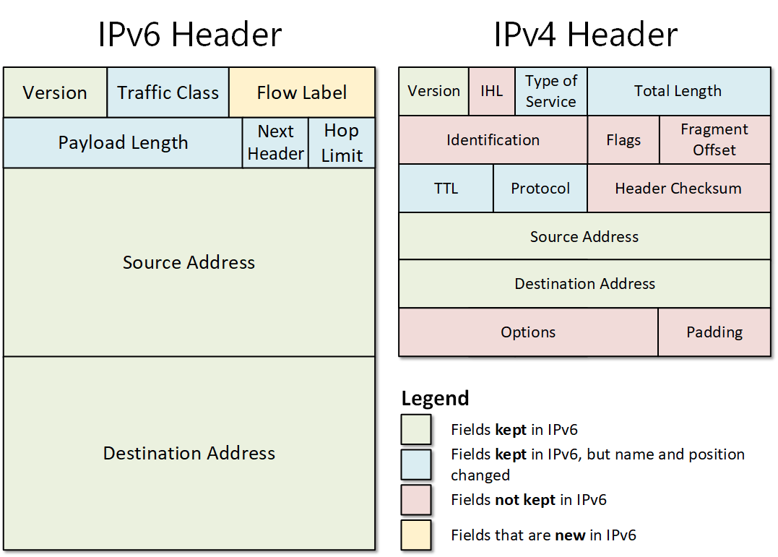
IPv6
Like IPv4, just better.
340,000,000,000,000,000,000,000,000,000,000,000,000 addresses (340 + 36 zeros).
No need for NAT, Integrated security and many goods with IPv6.
IPv6 Packet Header (40 Bytes), 16 Bytes for addresses.

Slide 33
Examples
2001:0DB8:0000:1111:0000:0000:0000:0200
Byte
Section
8 sections of four hex digits each → 8 * 4 * 4 = 128 bits.
Don’t use 2001:0DB8! (used in docs)
In reality, IPv6 start with 2::/3 (001x xxxx xxxx xxxx xxxx:)
Compressed formats:
No leading zeros: 2001:DB8:0:1111:0:0:0:200
Compressed (v1): 2001:DB8::1111:0:0:0:200
Compressed (v2): 2001:DB8:0:1111::200
Use :: only once! (But, why?)
Try to read this to understand why: 2001:DB8::1111::200.

Slide 34
IPv6 Particulars
Transmission: Unicast and Multicast as with IPv4
Also Anycast, i.e., sharing with the first to answer.
For instance, you see a house on fire (not yours) and make a call to the Fire Brigade. Which of the following is more reasonable?
“Hello, I would like to contact Ms Jane Doe for a certain incident at XYZ Street 123.”
“FIRE at XYZ Street 123!”
No broadcast!
Network prefix in IPv6:
Non-fixed length: anything between 0 and 128 bits.
Typically, /64.

Slide 35
ICMPv4 vs ICMPv6
ICMP (Internet Control Messaging Protocol): How to send error messages.
Similar messages for ICMPv4 and v6:
Host confirmation
Destination / Service Unreachable
Time exceeded
Route redirection
Ping: Send an echo packet (a packet that will be sent back once received) to make sure the target is there (much like poking someone to see if they are asleep).
Traceroute, the same except for error messages being shared by sender / target routers to identify a route.

Slide 36
What we saw today… 1 / n
What do we mean by the term “connectionless communication”?
By the term connectionless communication we refer to a communication where no connection is being / has been established prior to two partners exchanging messages / data.
At which OSI layer does IP live in?
Layer 3 (remember, it refers to logical addressing!)

Slide 37
What we saw today… 2 / n
Briefly describe the structure of an IPv4 header.

Slide 38
What we saw today… 3 / n
Convert the following IP from decimal to binary: 192.162.10.14
To convert the above, we convert each octet to its binary representation by repeatedly dividing by 2 and reading division moduli backwards. Thus, we get:
11000000.10100010.00001010.00001110
What are the network, host and broadcast addresses of 192.162.10.14/16?
/16 means we have a 16-bit (2 octet) subnet mask, i.e.: 255.255.0.0. AND-masking with that yields:
Network address: 11000000.10100010.00000000.00000000
Host address: 11000000.10100010.00001010.00001110
Broadcast address: 11000000.10100010.11111111.11111111

Slide 39
What we saw today… 4 / n
Right or Wrong? IPv4 allows all three: unicast, multicast and broadcast.
Right.
Right or Wrong? IPv4 allows all three: unicast, multicast and broadcast.
Wrong. It does not allow broadcast. Instead, it allows for anycasting.
What is anycast?
Anycast is sharing a message with the first responder from a given set of target devices (i.e., we target anyone certain group).

Slide 40
What we saw today… 5 / n
What are NAT and PAT?
Network Address Translation (NAT): Converts private to public IPv4 (e.g., through a firewall or other devices).
Port Address Translation (PAT): Converts many private IP to one public IP.
What are some typical ICMPv4/v6 messages?
Some typical ICMPv4/v6 messages include:
Host confirmation
Destination / Service Unreachable
Time exceeded
Route redirection

Slide 41
What we saw today… 6 / n
Briefly compare IPv6 and IPv4 packet headers.

Slide 42
Homework
Study the following Wikipedia Lemma on IPv6:
https://en.wikipedia.org/wiki/IPv6
Based on that and at least two more independent resources, provide a 400-600 words essay comparing IPv4 and IPv6 on various axes (make your own meaningful choices).
Share your essays at: v.markos@mc-class.gr

Slide 43
Fun Time!

Slide 44
Pen and Paper
Open your notebook or a blank sheet of paper.
Open ‘Derby Stuff > Lab > Week 7 Lab 1 Converting IPv4 Addresses to Binary_MC_2023.pdf’ and have fun!
Let’s check some stuff all together…
Open ‘Derby Stuff > Lab > Week 7 Lab 1 Converting IPv4 Addresses to Binary_MC_2023.pdf’ and have more fun!
Let’s check some stuff all together again…

Slide 45
Really interesting materials
Check out this youtube playlist:
https://www.youtube.com/watch?v=nlKu93Gb6GQ&list=PLvUOx2WG6R7PlKlERb5zceXxHfC4P7gJn
Many projects that will look like your final assignment!

Slide 46
(Reminder) NetAcad Courses
In the “Download Packet Tracer” page, above the “Download” section, you can find three interesting courses (interesting course: a course is characterised as “interesting” to inform someone that they should take it, without telling them to do so directly):
Getting Started with Cisco Packet Tracer
Exploring Networking with Cisco Packet Tracer
Exploring IoT with Cisco Packet Tracer
Also interesting is the following NetAcad course:
Network Technician

Slide 47

Any Questions?
Don’t forget to fill-in the questionnaire! (look right)
https://forms.gle/6q2tuByroaan8kWH8

